Slide 1
FPGA Packet Filter With Custom Ethernet MAC and Webserver on RISC-V
Undergraduate thesis semiar
Student : Matthew Gilpin 45801600
Supervisor: Dr Matthew D’Souza

Slide 2
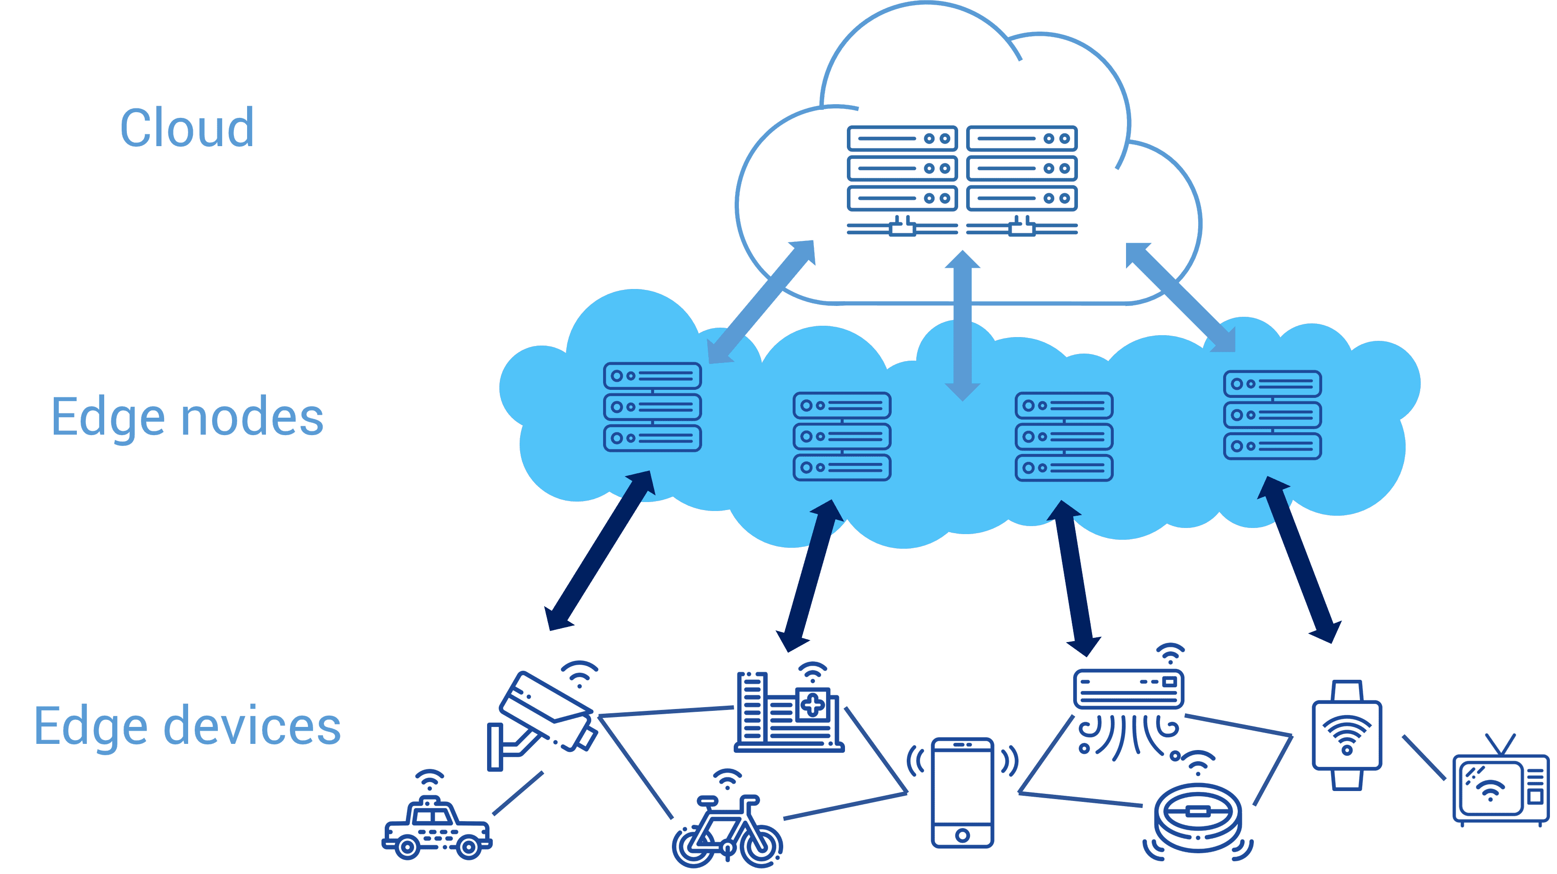
Edge networks and Security
Move computing to the edge – closer to the source of data.
Low power, highly distributed systems.
Increasing security is needed
‘5 tuple’ fields to filter on - Source IP, Dest IP, Source Port, Dest Port, Protocol

Slide 3
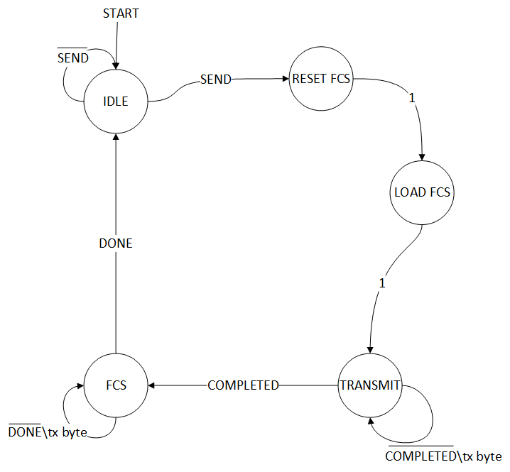
FPGAs
Custom logic – define own architecture
Allows for optimisation
Allows for parallelisation
System on Chips (SoC)
Use case in Ethernet MACs - Calculate FCS (CRC32) on the fly - Filter data at wirespeed - All while processor can be doing other things - Equates to low latency and high throughput.

Slide 4
RISC-V
Used for running webserver
Easier to write software than hardware – faster development cycle

Slide 5
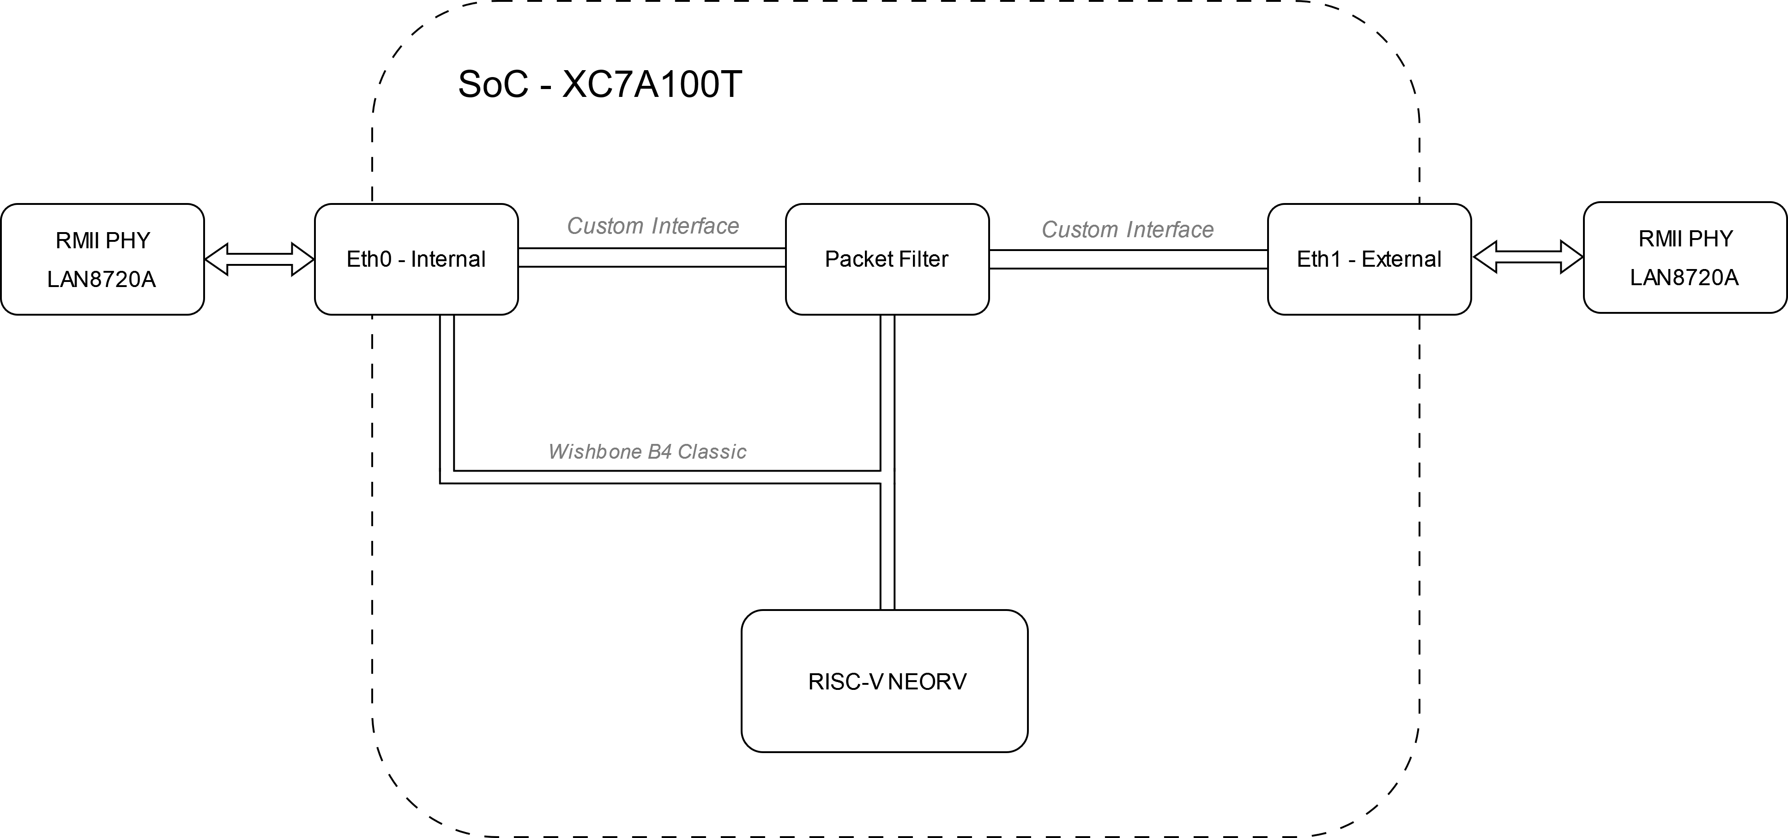
Implementation
Using neorv32 – RISC-V softcore written in vendor agnostic VHDL
Custom Ethernet MAC
FreeRTOS with FreeRTOS Plus TCP stack
Currently at 50Mhz, intend to be 75Mhz or 100Mhz.
Why an FPGA

Slide 6
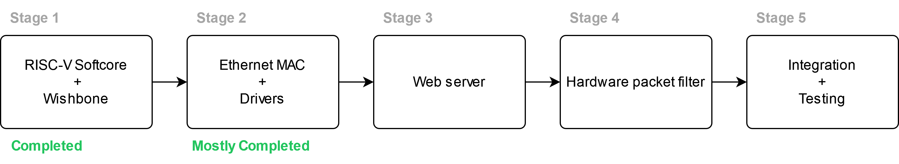
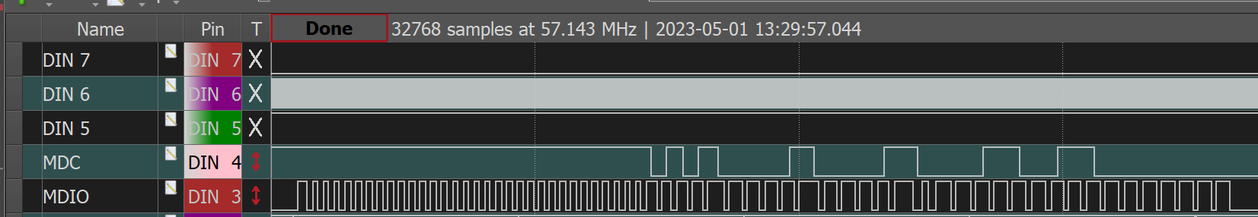
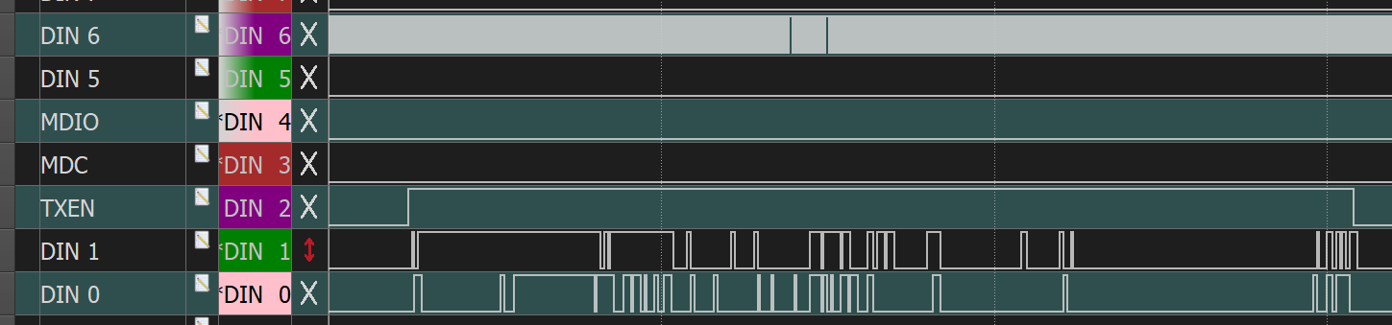
Progress

Slide 7
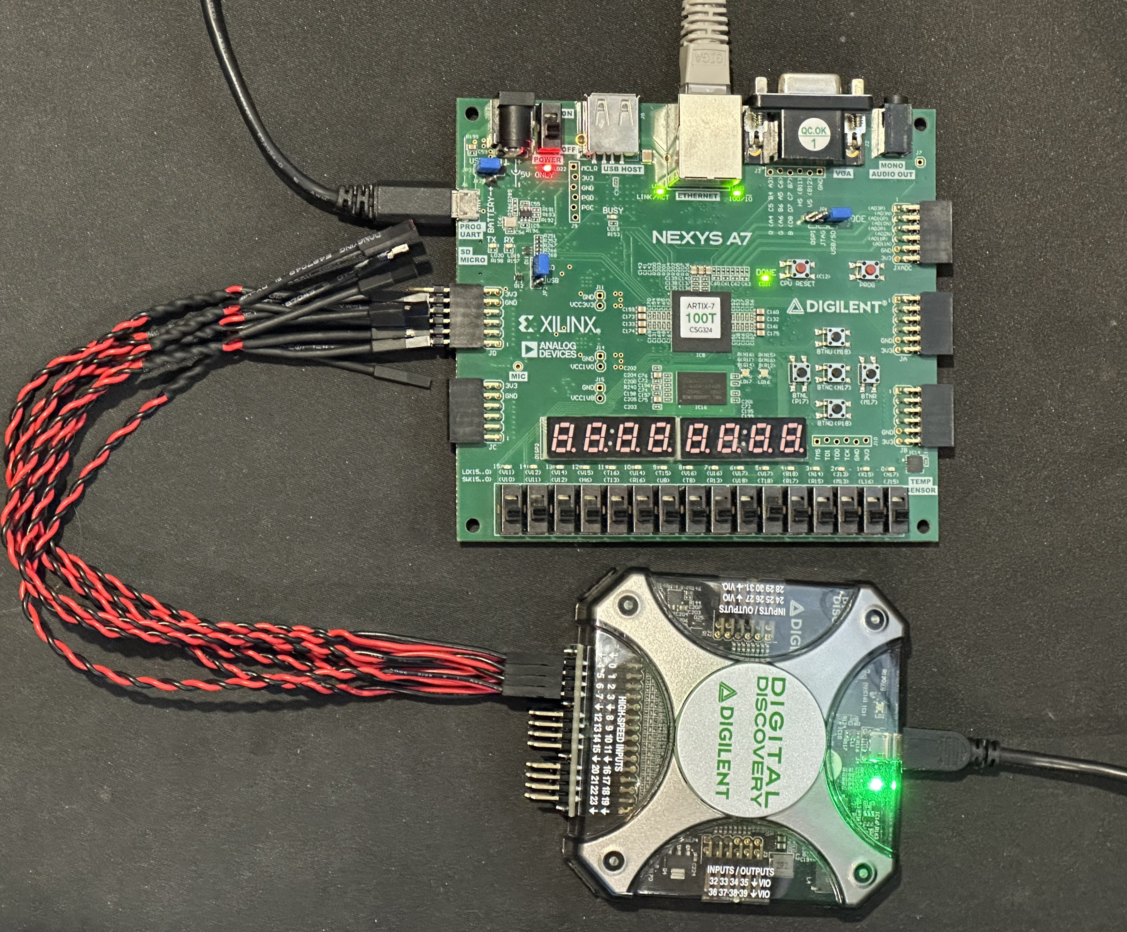
Testing
Testing with a Digilent Digital Discovery – 800MSa/s
Also using simulations in Vivado to reduce time waiting for synthesis

Slide 8
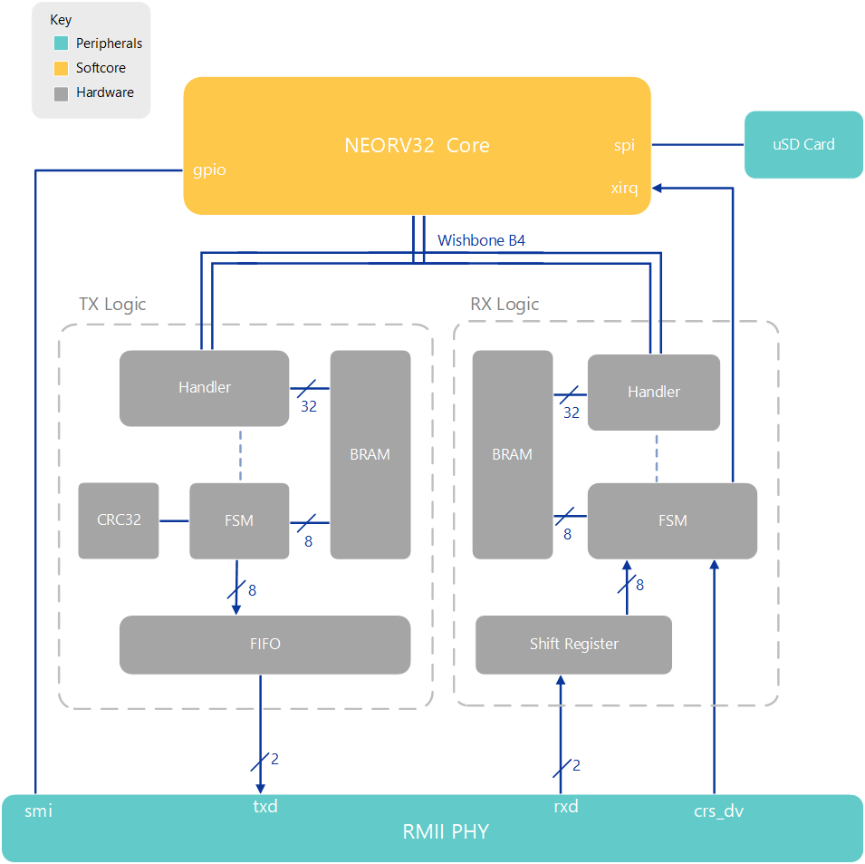
Current hardware state
Handler deals with memory and wishbone
FSM handles the data manipulation
FIFO and Shift Register used to cross clock domains
Packets get built and stored in BRAM
FCS (CRC32) calculated on the fly

Slide 9
Tricks
Talk about receive logic and tie into how that could be used in the pattern matching – learned in coding interview

Slide 10
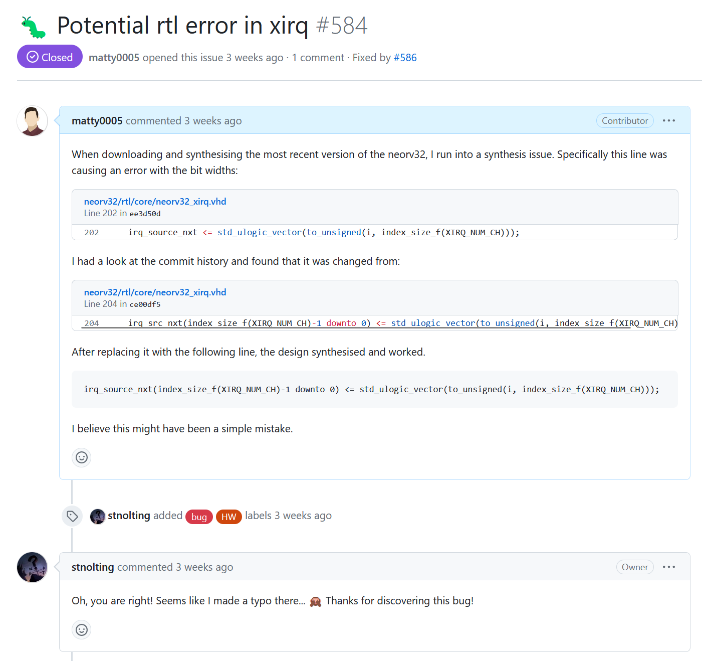
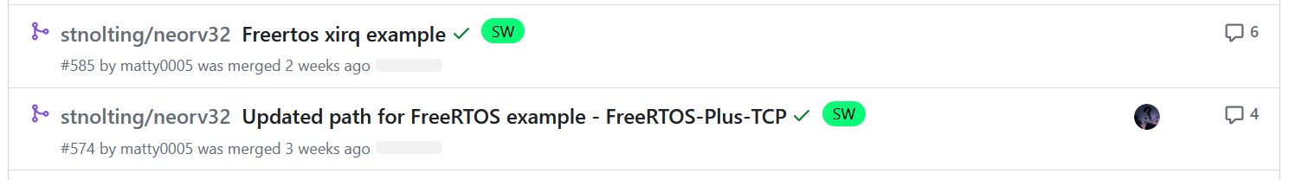
Contributions – neorv32
Detected hardware errors + added external interrupts with FreeRTOS example.

Slide 11
Project plan
Complete Receive logic
Fix up transmit logic to properly send out of RMII PHY
Create simple webserver
Create hardware filtering mechanism
Tie that into the existing system.

Slide 12
Contact
Matthew Gilpin
m.gilpin@uq.edu.au

